Slide 1
Installation Guide
(Web Server – WebtoB 4.1)
2009. 07. 21
CODELABOR
Shin Sang Jae (codelabor@gmail.com)

Slide 2

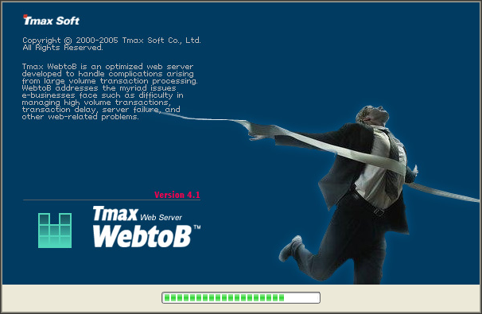
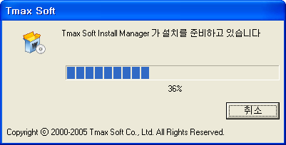
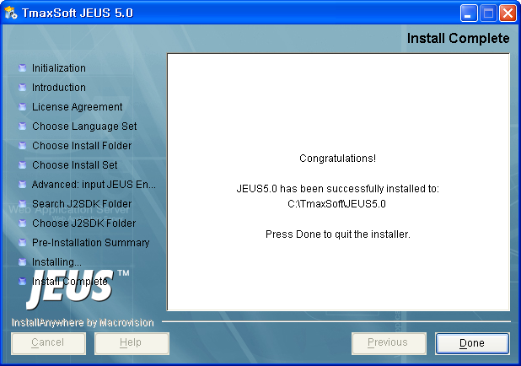
WebtoB
Install
File: WebtoB4.1_Full_Win.exe

Slide 3
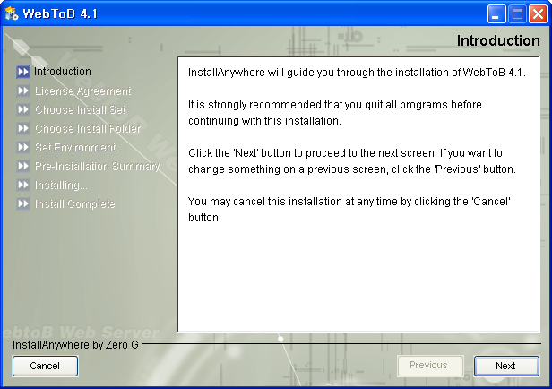
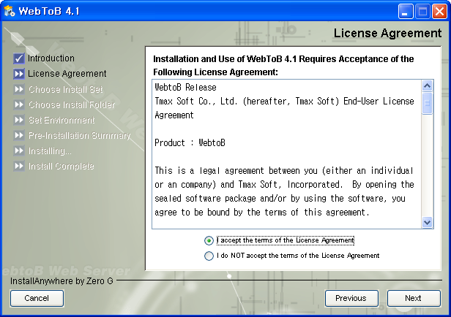
WebtoB
Install

Slide 4
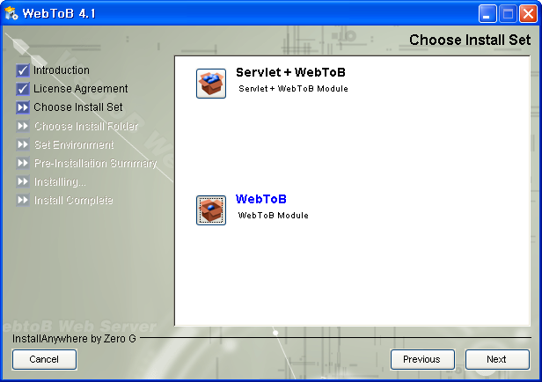
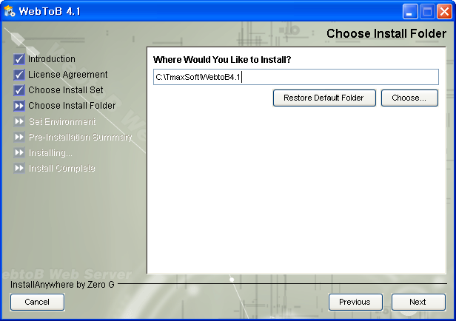
WebtoB
Install
Install Set: WEbToB
Install Directory: C:\TmaxSoft\WebtoB4.1

Slide 5
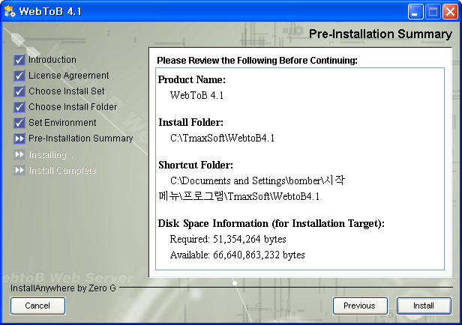
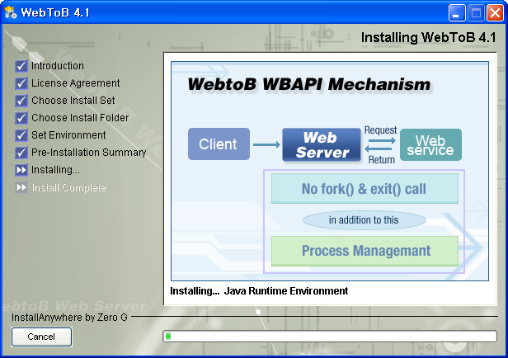
WebtoB
Install

Slide 6
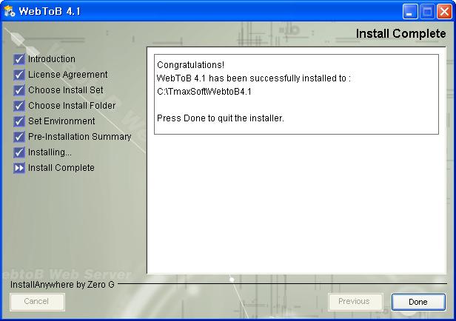
WebtoB
Install

Slide 7
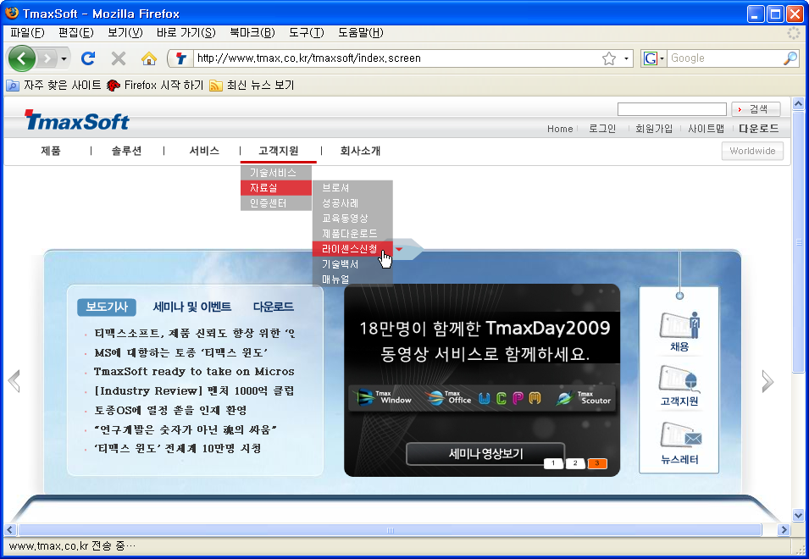
WebtoB
Issue License
Official Site: http://www.tmax.co.kr
Menu: 고객지원 > 자료실 > 라이센스 신청

Slide 8
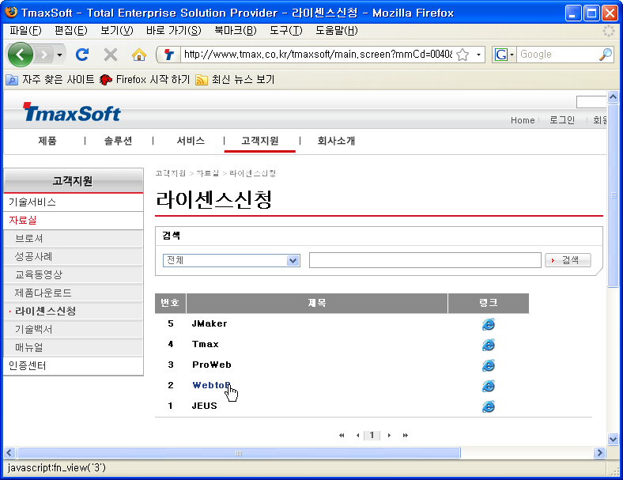
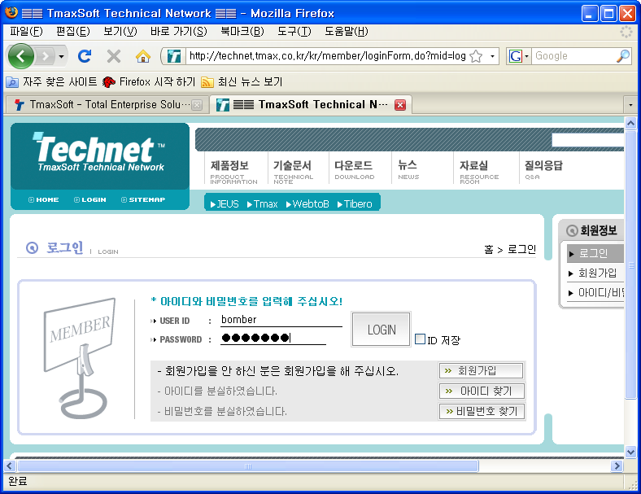
WebtoB
Issue License
Choose WebtoB
Link to technet
Login

Slide 9
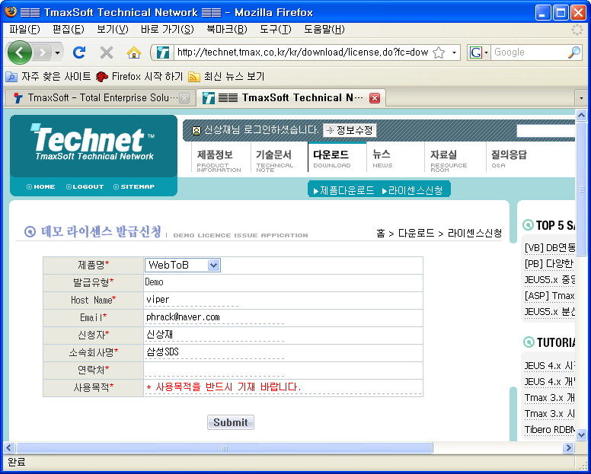
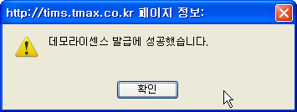
WebtoB
Issue License
Fill out the form
Check you email

Slide 10
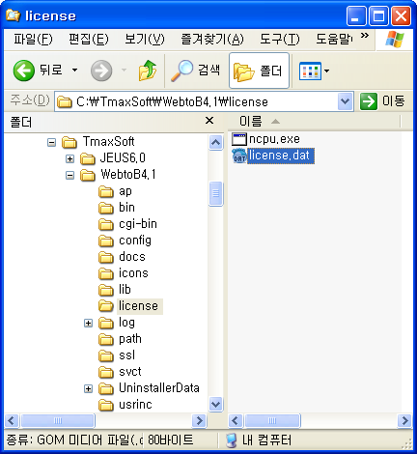

WebtoB
Install License
Install license
License Directory: C:\TmaxSoft\WebtoB4.1\license

